Slide 1


MPC Lab – HMC Meeting
Eric Choi, Mark Pustilnik, Hansung Kim, and Francesco Borrelli
8/25/2025

Slide 2
Agenda
Recap
Technical Updates
  Sample data analysis
  Suggest An energy Model to fit the dara
Discussion
  Future Roles and Responsib

Slide 3
Recap

Slide 4


Project Overview
Objective: Develop and validate a road grade-aware energy consumption estimation model for electric vehicles
Duration: 7 months (June – December 2025)

Slide 5
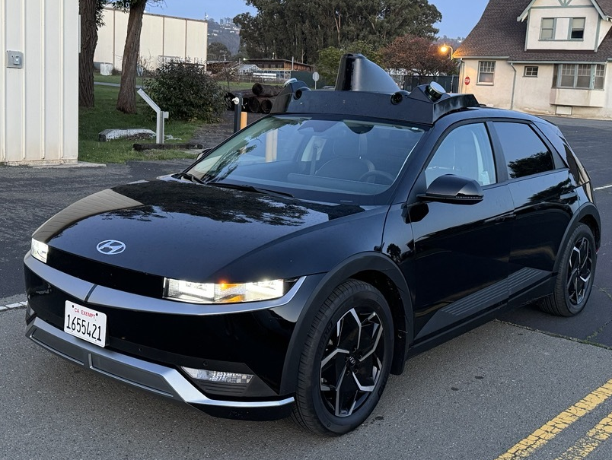
UCB Vehicle Platform
Model: 2023 Hyundai IONIQ 5
Signals:
Vehicle
  Speed, wheel torque, etc.
Energy
  High/Low voltage battery power, SOC, etc.
IMU
  Accel., pitch angles, etc.
GPS
  Latitude, Longitude, and Altitude
  (optional) Altitude through Google or HERE API

Slide 6
Literature Review

Slide 7
Academic Papers
There are many academic papers that try to model the effects of sloped road on EV range performance
Most give a general model and not a vehicle specific (based on mass and road grade)
Some standout papers:
  Oriol Travesset-Baro, Transport energy consumption in mountainous roads. A comparative case study for internal combustion engines and electric vehicles in Andorra (2015) – Talk about the difference between powertrain types on range performance on hilly road
  Xiaodan Xu, A modal-based approach for estimating electric vehicle energy consumption in transportation networks (2019) - statistically-based energy model derived from simulator
  Heran Shen, An Experimental Comparison of Physics-based and Machine-Learning-based Electric Vehicle Energy Consumption Estimation Methods (2023) – suggests that ML methods superior in accuracy but only on roads with enough data

Slide 8
Technical Update

Slide 9
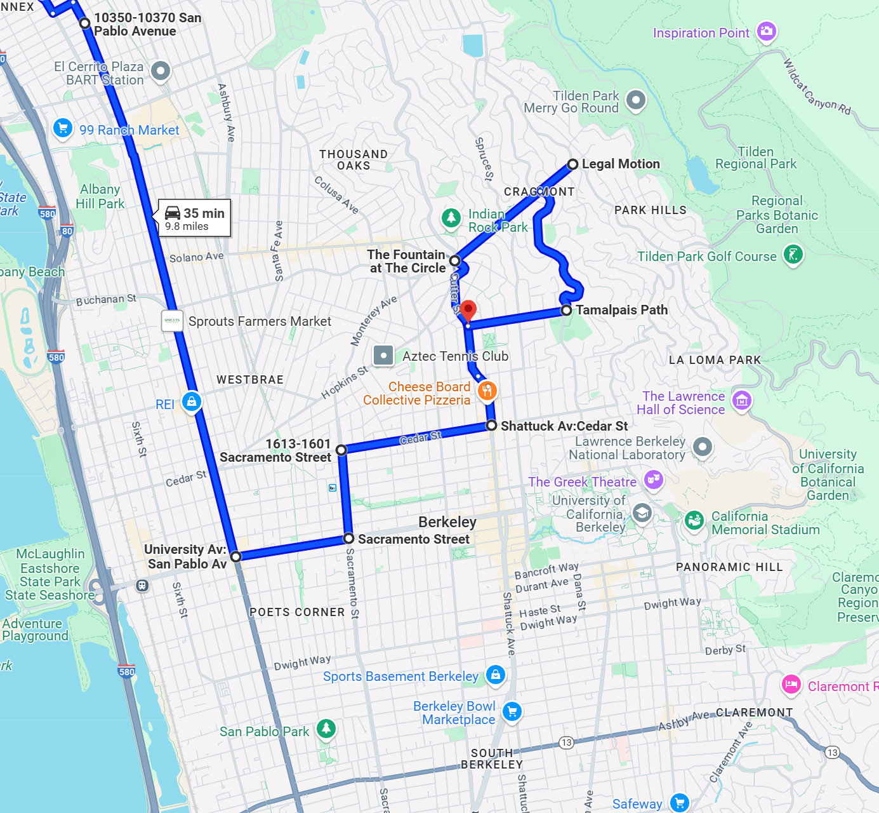
Sample Data Collection
Objective: Collect representative driving data across flat, moderate, and steep road segments to capture diverse road grade effects
Route Selected: Berkeley, California
Signals Evaluated:
Energy
Vehicle data
Road grade

Slide 10
Energy Usage Measurement
In this work, we measure energy consumption using the following high-voltage battery signals:
high-voltage battery current,
high-voltage battery voltage.
Additionally, we record auxiliary power usage (e.g., air conditioning and other onboard systems).

Slide 11
Background: Factors Affecting EV Energy Consumption
Before discussing the impact of road grade on energy consumption, let’s consider the broader factors influencing a vehicle’s energy usage.
Road grade not only affects vehicle measurements, but vehicle behavior itself also plays a significant role in energy consumption.
From UC Berkeley’s previous studies on electric vehicle energy usage, higher driving speeds have been shown to lead to increased energy consumption.
  Electric vehicles are less impacted by stop-and-go driving compared to internal combustion engine (ICE) vehicles.

Slide 12
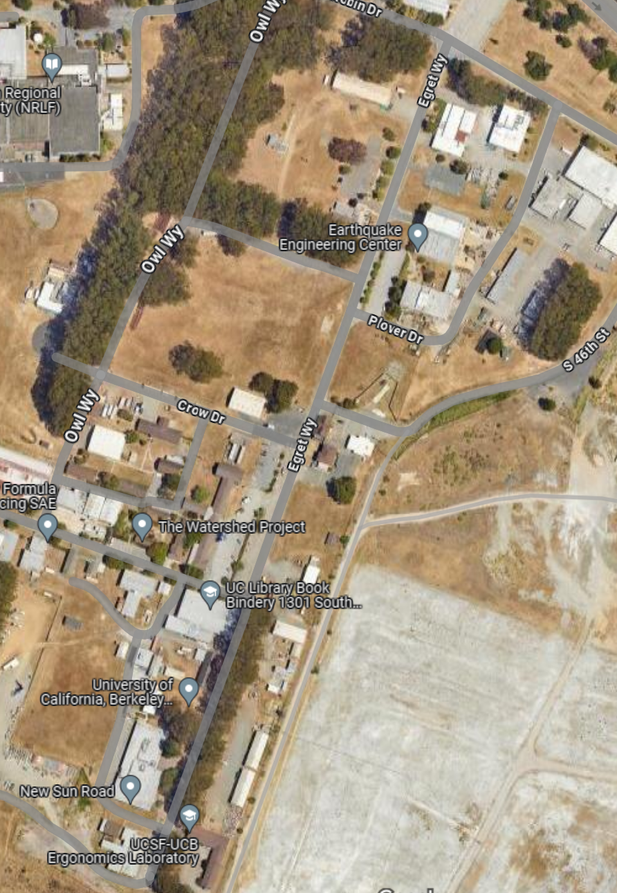
Background: Factors Affecting EV Energy Consumption
START
The vehicle travels in a straight line for approximately 450 meters (0.28 miles).
In each experiment, we vary the vehicle's reference speed.
Instead of using a human driver, we designed a controller to maintain a constant reference speed, consistent acceleration, and deceleration for each run.
Goal: Observe how energy usage varies with different traveling speeds over the same distance.
END

Slide 13
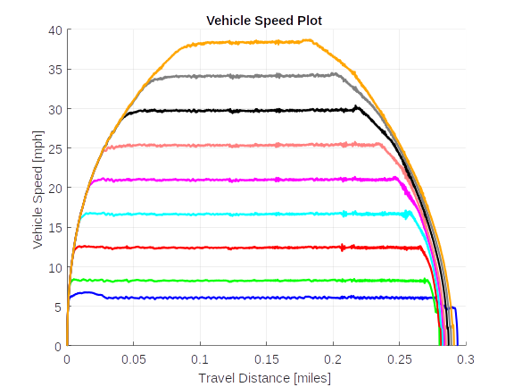
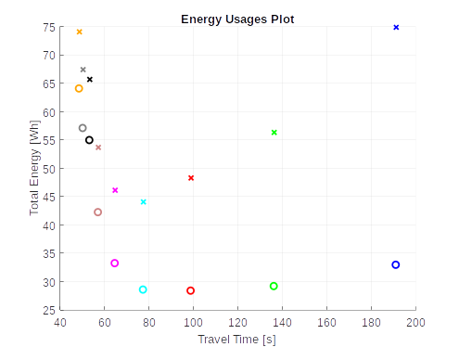


Background: Factors Affecting EV Energy Consumption
The same color corresponds to the same run for the two figures above.
: High Voltage Battery Usage
: High Voltage Battery Usage – Auxiliary Power Usage (Motion Energy)

Slide 14
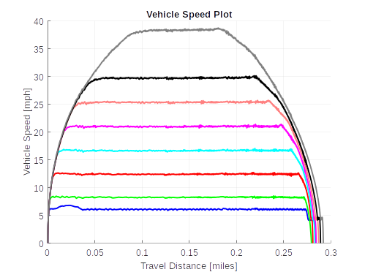
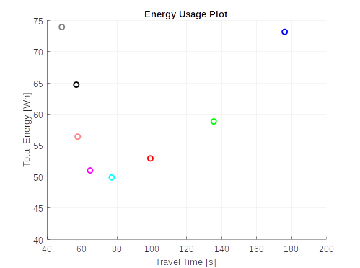
Background: Factors Affecting EV Energy Consumption
The experiments were repeated with AC usage averaging approximately 440 watts.

Slide 15
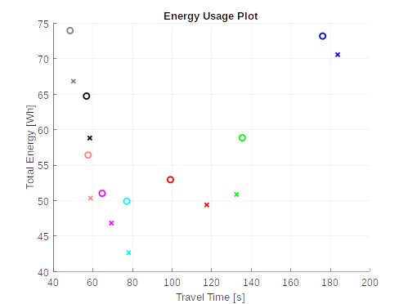
Background: Factors Affecting EV Energy Consumption
O: With AC usage
X: Without AC usage
The experiments were repeated without AC usage. As a result, energy consumption decreased by 9.2% on average in experiments without AC usage.

Slide 16
Background: Factors Affecting EV Energy Consumption
Based on this experiment, when comparing the impact of road grade on energy consumption, it is important to account for:
Auxiliary power usage (e.g., air conditioning)
Vehicle speed (travel time)
O: With AC usage
X: Without AC usage
The experiments were repeated without AC usage. As a result, energy consumption decreased by 9.2% on average in experiments without AC usage.

Slide 17
Sample Data Collection
Flat Road
Moderate Road Grade
Steep Road Grade
Total traveled distance: ~1000 m
Normalize all Recordings to 1000m travel distance
Normal Driving Mode
Regen Level 1

Slide 18
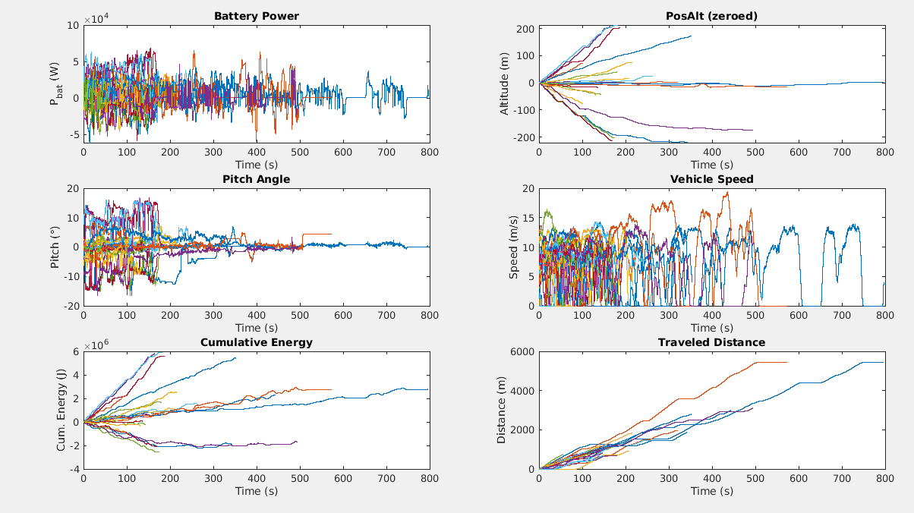
Sample Data Collection

Slide 19

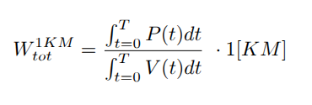
Data Analysis
We look at the net battery power associated with driving the car – total battery energy consumption minus the AC power consumption:
The energy of each section is normalized to 1[KM]:

Slide 20
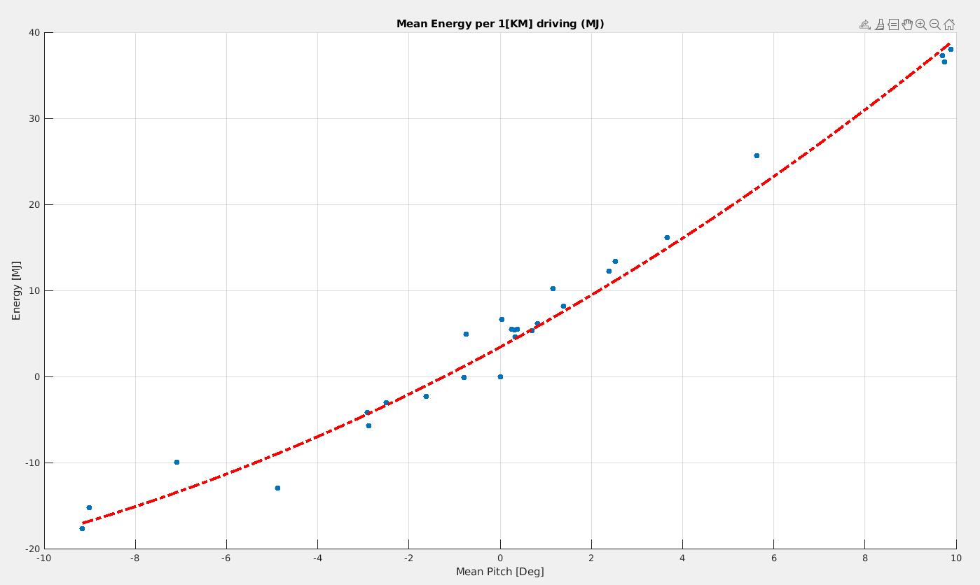
Data Analysis
The mean Energy it takes to drive 1[Km] at a specific road slope
The measurements seem to fit a parabolic model
Going uphill and down hill is not the same (not bias)

Slide 21
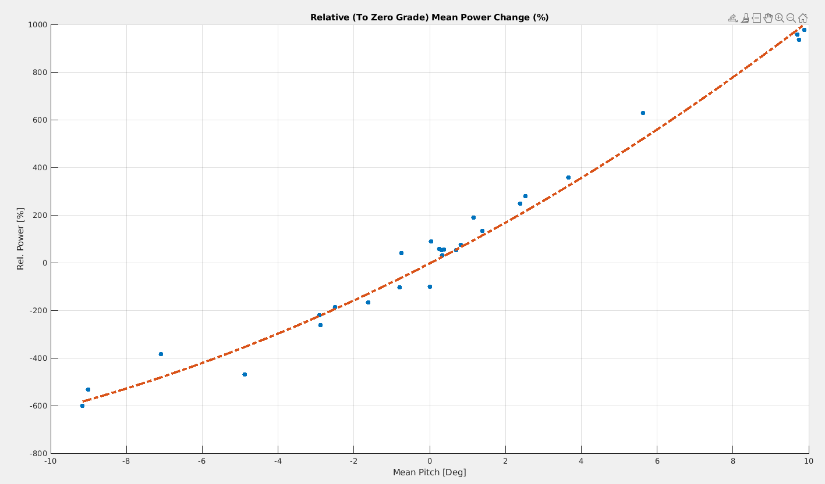
Data Analysis
The relative change in power consumption
Driving on a flat road is not the same as driving uphill and then downhill
It is a dominant factor in planning for EV route plannig

Slide 22
Discussion

Slide 23
Discussion
How general the model should be (different types of cars, different configurations)?
Will we be able to record some data for every car type to adapt the grade dependence model
What’s the accuracy we are looking for?
Next meeting
Midterm report

Slide 24
Summery
Compare the road grade between car measurements to other data source
Collect more data points with different gen-level (level 3)
Talk to eric about “3d energy model predictor”
Midterm report - send before 09/19
Next meeting - 09/23

